Slide 1
Servlet
By,
N.C.Varnagar

Slide 2
ServletConfig
An object of ServletConfig is created by the web container for each servlet. This object can be used to get configuration information from web.xml file.
If the configuration information is modified from the web.xml file, we don't need to change the servlet. So it is easier to manage the web application if any specific content is modified from time to time.

Slide 3
Advantage of ServletConfig
The core advantage of ServletConfig is that you don't need to edit the servlet file if information is modified from the web.xml file.
Methods of ServletConfig interface
public String getInitParameter(String name):Returns the parameter value for the specified parameter name.
public Enumeration getInitParameterNames():Returns an enumeration of all the initialization parameter names.
public String getServletName():Returns the name of the servlet.
public ServletContext getServletContext():Returns an object of ServletContext.
public ServletConfig getServletConfig():Returns an object of ServletConfig.

Slide 4
In web.xml – <init-param> tag will appear under <servlet-class> tag
<servlet>
<servlet-name>ServletConfigTest</servlet-name>
<servlet-class>com.ServletConfigTest</servlet-class>
<init-param>
<param-name>topic</param-name>
<param-value>Difference:ServletConfig vs ServletContext
</param-value>
</init-param>
</servlet>

Slide 5
ServletContext Interface
An object of ServletContext is created by the web container at time of deploying the project. This object can be used to get configuration information from web.xml file. There is only one ServletContext object per web application.
If any information is shared to many servlet, it is better to provide it from the web.xml file using the <context-param> element.

Slide 6
Advantage of ServletContext
Easy to maintain if any information is shared to all the servlet, it is better to make it available for all the servlet. We provide this information from the web.xml file, so if the information is changed, we don't need to modify the servlet. Thus it removes maintenance problem

Slide 7
There is given some commonly used methods of ServletContext interface. public String getInitParameter(String name):Returns the parameter value for the specified parameter name. public Enumeration getInitParameterNames():Returns the names of the context's initialization parameters. public void setAttribute(String name,Object object):sets the given object in the application scope. public Object getAttribute(String name):Returns the attribute for the specified name. 5.public void removeAttribute(String name):Removes the attribute with the given name from the servlet context.

Slide 8
In web.xml – <context-param> tag will be appear under <web-app> tag:
<context-param>
<param-name>driver</param-name>
<param-value>oracle driver</param-value>
</context-param>

Slide 9
Difference: ServletConfig vs Servlet Context

Slide 10
Servlet by using Annotation
Import any one packages:
Javax.servlet.annotation.*;
OR
Javax.servlet.annotation.WebServlet;
Syntax:
1. @WebServlet(name=“FirstServlet2”,urlPatterns=“/ FirstServlet2”)
2. @WebServlet(name=“FirstServlet2”,urlPatterns=“/ FirstServlet2”,initParams={@webInitParam(name=“greeting”,value=“welcome”)})

Slide 11
Request Delegation (Request Dispatcher)
The RequestDispatcher interface provides the facility of dispatching the request to another resource it may be html, servlet or jsp. This interface can also be used to include the content of another resource also. It is one of the way of servlet collaboration.

Slide 12
The RequestDispatcher interface provides two methods.
They are:
public void forward(ServletRequest request,ServletResponse response)throws ServletException,IOException:Forwards a request from a servlet to another resource (servlet, JSP file, or HTML file) on the server.
public void include(ServletRequest request,ServletResponse response)throws ServletException,IOException:Includes the content of a resource (servlet, JSP page, or HTML file) in the response.

Slide 13
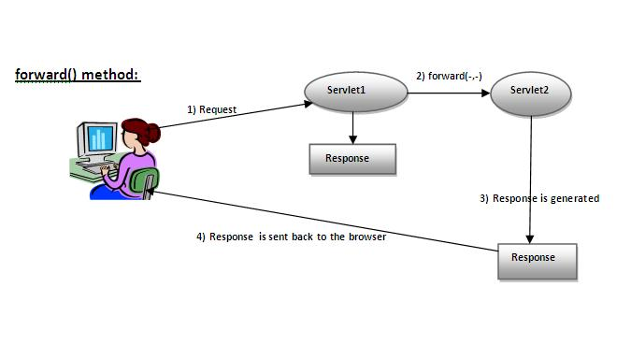

Slide 14
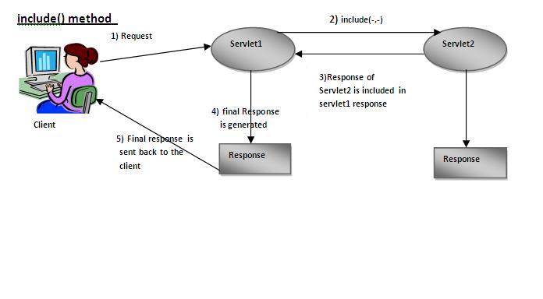

Slide 15
➔How to get the object of RequestDispatcher
The getRequestDispatcher() method of ServletRequest interface returns the object of RequestDispatcher. Syntax:
➔Syntax of getRequestDispatcher method
public RequestDispatcher getRequestDispatcher(String resource);
➔Example of using getRequestDispatcher method
RequestDispatcher rd=request.getRequestDispatcher("servlet2");
//servlet2 is the url-pattern of the second servlet
rd.forward(request, response);//method may be include or forward

Slide 16
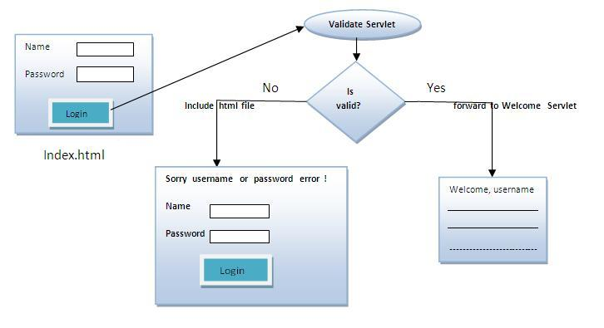
Program

Slide 17
Servlet Attributes
An attribute in servlet is an object that can be set, get or removed from one of the following scopes:
1.request scope
2.session scope
3.application scope
The servlet programmer can pass information's from one servlet to another using attributes. It is just like passing object from one class to another so that we can reuse the same object again and again.

Slide 18
RequestScope A ‘request’ scope parameter/attribute can be accessed from any of servlets or jsps that are part of serving one request. For example, you call one servlet/jsp, it then calls another servlet/jsp and so on, and finally the response is sent back to the client.
Request scope is denoted by javax.servlet.http.HttpServletRequest interface.
Container passes the request object as an argument of type HttpServletRequest to Servlet's service method.

Slide 19
session scope
A session scope starts when a client (e.g. browser window) establishes connection with our web application till the point where the browser window is closed.
Session scope spans across multiple requests from the same client.
Session scope is denoted by javax.servlet.http.HttpSession interface.
In a servlet, you can get Session object by calling request.getSession().

Slide 20
Application or context scope
Context scope or application scope starts from the point where a web application is put into service (started) till it is removed from service (shutdown) or the web application is reloaded. Parameters/attributes within the application scope will be available to all requests and sessions.
Application scope is denoted by javax.servlet.ServletContext interface.
In a servlet, you can get application object by calling getServletContext() from within the servlets code directly (the servlet itself implements the ServletConfig interface that contains this method) or by explicitly calling getServletConfig().getServletContext().

Slide 21
Servlet Request & Servlet Response
Read from material

